Slide 1


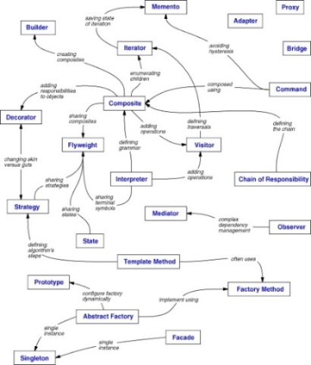
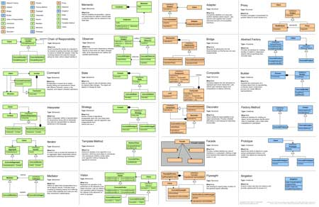
Design Patterns II
Structural, Behavioral and Others
SoftUni Team
Technical Trainers
http://softuni.bg
Software University

Slide 2

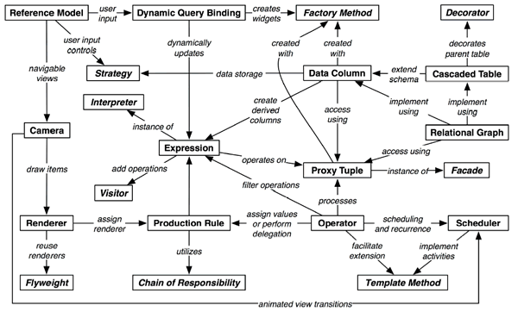
Table of Contents
Structural Patterns
Behavioral Patterns
Architectural Patterns
Other Patterns

Slide 3
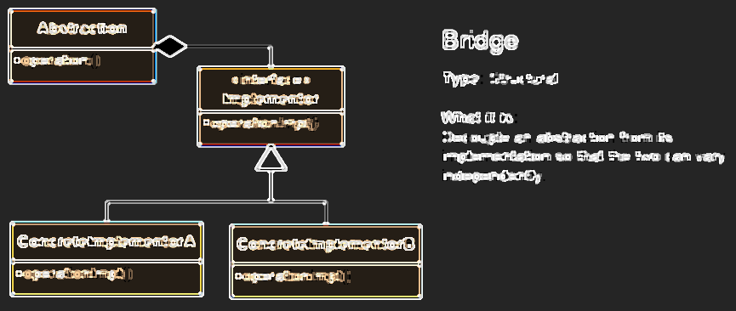
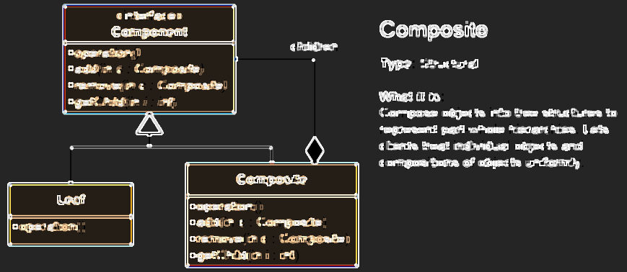
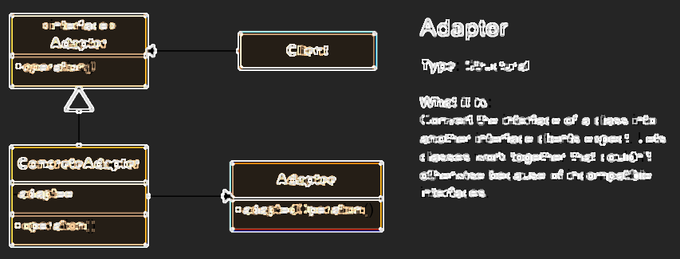
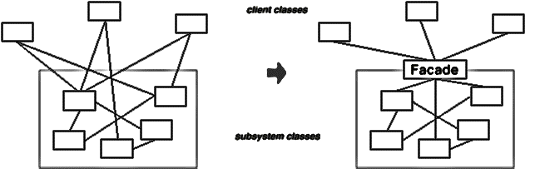
Structural Patterns

Slide 4
Structural Patterns
Describe ways to assemble objects to implement a new functionality
Ease the design by identifying a simple way to realize relationships between entities
This design patterns is all about Class and Object composition
Structural class-creation patterns use inheritance to compose interfaces
Structural object-patterns define ways to compose objects to obtain new functionality

Slide 5
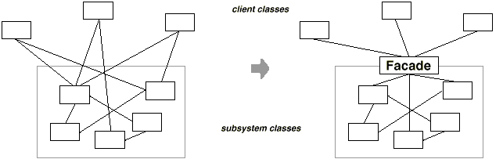
Facade Pattern
To deliver convenient interface from higher level to group of subsystems or single complex subsystem
Façade pattern used in many Win32 API based classes to hide Win32 complexity

Slide 6
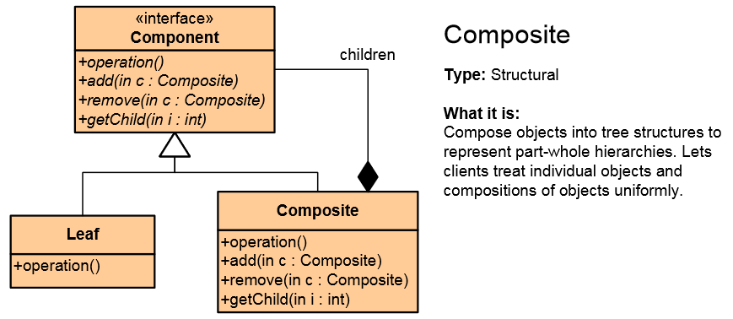
Composite Pattern
Composite Pattern allows to combine different types of objects in tree structures
Gives the possibility to treat the same individual objects or groups of objects
Used when
You have different objects and you want to treat them the same way
You want to present a hierarchy of objects

Slide 7
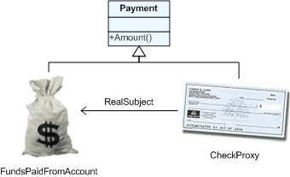
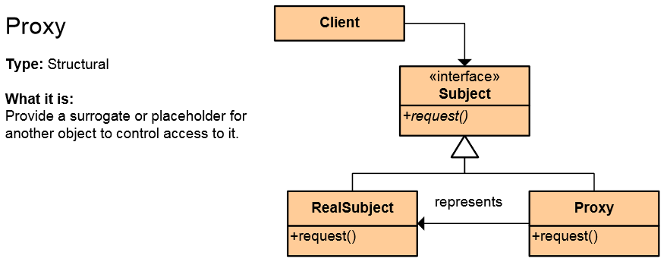
The Proxy Pattern
An object representing another object
Provide a surrogate or placeholder for another object to control access to it
Use an extra level of indirection
to support distributed, controlled, or intelligent access
Add a wrapper and delegation to
protect the real component from undue complexity
Example: Web Service

Slide 8
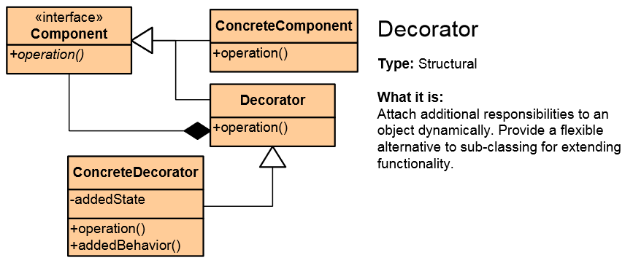
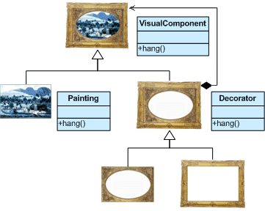
Decorator Pattern
Add responsibilities to objects dynamically
Wrapping original component
Alternative to inheritance (prevents class explosion problem)
Support Open-Closed principle
In .NET: CryptoStream decorates Stream

Slide 9
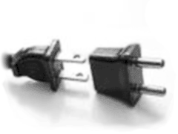
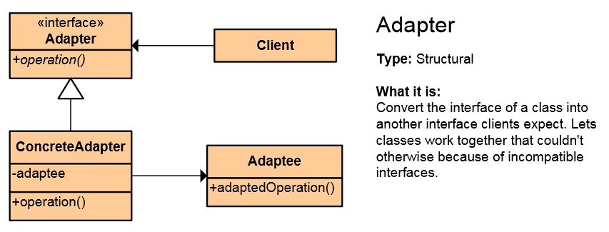
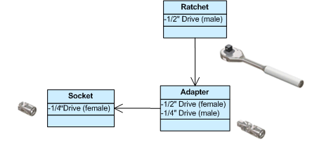
Adapter Pattern
Converts the given class' interface into another class requested by the client
Wrap an existing class with a new interface
Impedance match an old component to a new system
Allows classes to work together when this is impossible due to incompatible interfaces

Slide 10

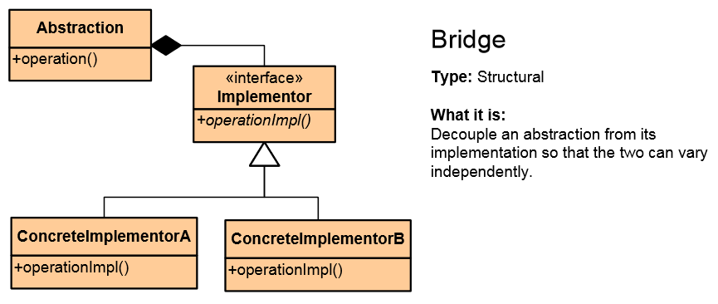
Bridge Pattern
Used to divide the abstraction and its implementation (they are by default coupled)
That way both can be rewritten independently
Solves problems usually solved by inheritance
From: Abstraction -> Implementation To: Abstraction -> Abstraction -> Implementation

Slide 11
Proxy vs. Decorator vs. Adapter vs. Bridge
Proxy – to lazy-instantiate an object, or hide the fact that you're calling a remote service, or control access to the object (one-to-one interface)
Decorator – to add functionality to an object runtime (not by extending that object's type)
Adapter – to map an abstract interface to another object which has similar functional role, but a different interface (changes interface for the client)
Bridge – define both the abstract interface and the underlying implementation. I.e. you're not adapting to some legacy or third-party code, you're the designer of all the code but you need to be able to swap out different implementations (all changeable)

Slide 12
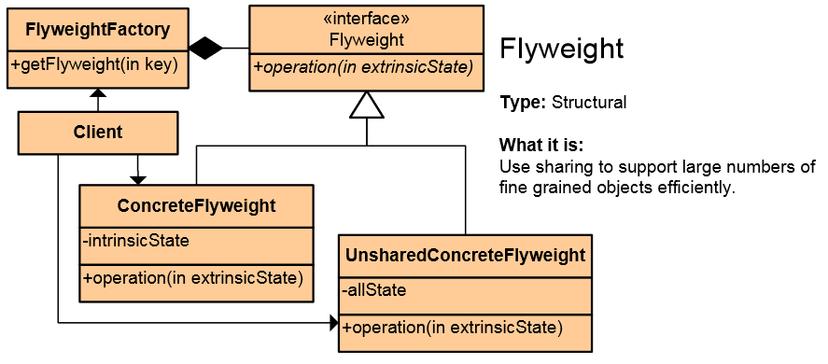

Flyweight Pattern
Use sharing to support large numbers of fine-grained objects efficiently
Reduce storage costs for large number of objects
Share objects to be used in multiple contexts simultaneously
Retain object oriented granularity and flexibility

Slide 13
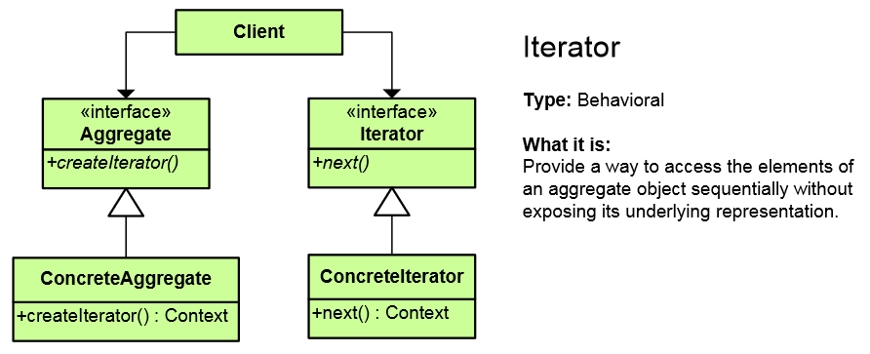
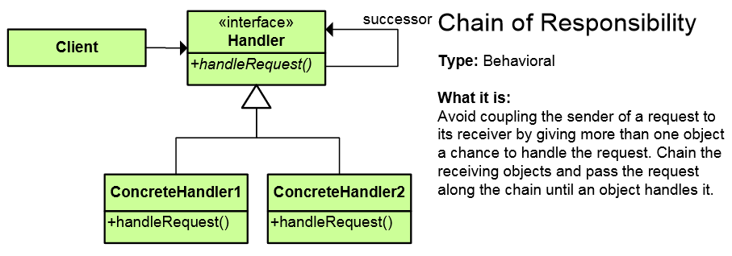
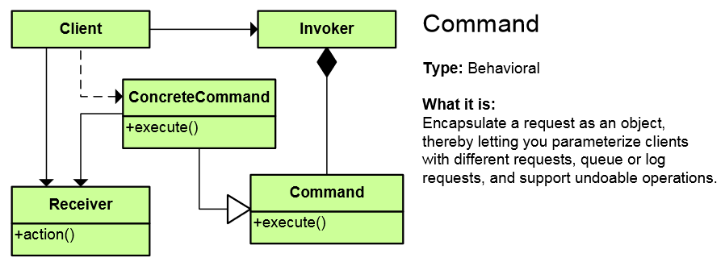
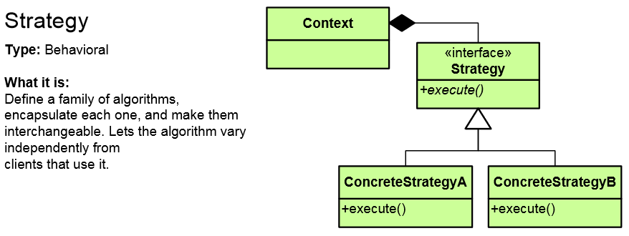
Behavioral Patterns

Slide 14
Behavioral Patterns
Concerned with communication (interaction) between the objects
Either with the assignment of responsibilities between objects
Or encapsulating behavior in an object and delegating requests to it
Increase flexibility in carrying out cross-classes communication

Slide 15
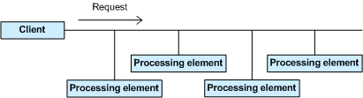
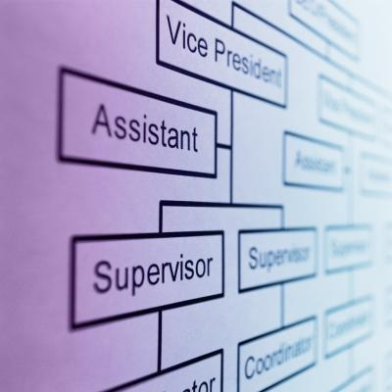
Chain of Responsibility Pattern
Allows you to pass a request to form an object to the next until the request is fulfilled
Analogous to the exception handling
Simplifies object interconnections
Each sender keeps a single reference to the next

Slide 16
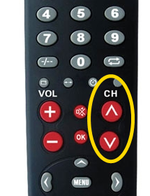
Iterator Pattern
Access to the elements of a complex object without revealing its actual presentation
Various ways of data structure traversing
Unified interface for iterating over various data structures
foreach loops in C# use the Iterator pattern

Slide 17
Iterator – Example
public interface IEnumerator {
bool MoveNext();
object Current { get; }
void Reset(); }
public interface IEnumerable {
IEnumerator GetEnumerator();
}
private class ConcreteEnumerator : IEnumerator {
// Implement IEnumerator interface
}
var enumerator = someObject.GetEnumerator();
enumerator.Reset();
while (enumerator.MoveNext()) {
// work with enumerator.Current
}

Slide 18
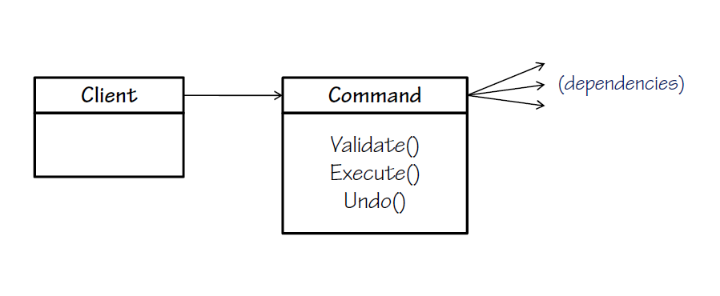
The Command Pattern
An object encapsulates all the information needed to call a method at a later time
Letting you parameterize clients with different requests, queue or log requests, and support undoable operations
Command in WPF and Silverlight encapsulate a request to call a method with parameters

Slide 19

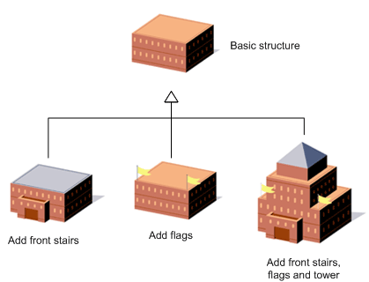
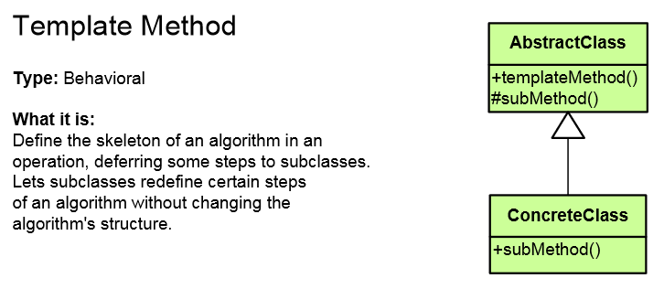
Template Method Pattern
Defines the base of an algorithm in a method, leaving some implementation to its subclasses
Template Method allows the subclasses to redefine the implementation of some of the parts of the algorithm
Doesn't let the subclasses change the algorithm
structure
Relies on inheritance; Strategy on composition

Slide 20
Template Method – Example
public abstract class HotDrink {
public void PrepareRecipe()
{
BoilWater(); Brew(); PourInCup(); AddSpices();
}
protected abstract void Brew();
protected abstract void AddSpices();
private void BoilWater() { ... }
private void PourInCup() { ... }
}
public class Coffee : HotDrink {
protected override void Brew() { ... }
protected override void AddSpices() { ... }
}
public class Tea : HotDrink {
protected override void Brew() { ... }
protected override void AddSpices() { ... }
}
Implemented by subclasses

Slide 21
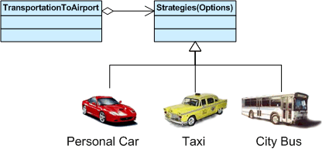
Strategy Pattern
Encapsulates an algorithm inside a class
Making each algorithm replaceable by others
All the algorithms can work with the same data transparently
The client can transparently work with each algorithm

Slide 22
Strategy Pattern – Example
abstract class SortStrategy {
public abstract void Sort(IList<object> list);
}
class QuickSort : SortStrategy {
public override void Sort(IList<object> list) { ... }
}
class MergeSort : SortStrategy {
public override void Sort(IList<object> list) { ... }
}
class SortedList {
private IList<object> list = new List<object>();
public void Sort(SortStrategy strategy) {
// sortStrategy can be passed in constructor
sortStrategy.Sort(list);
}
}

Slide 23
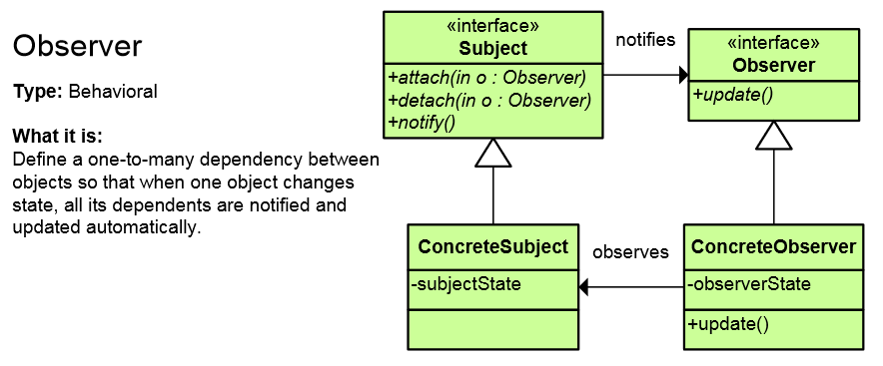
Observer Pattern
Presents interface allowing object to communicate without any concrete knowledge about each other
Also known as Publish-Subscribe pattern
Object to inform other object about its state, without the knowledge which are these objects
In .NET Framework events and event handlers use this pattern

Slide 24
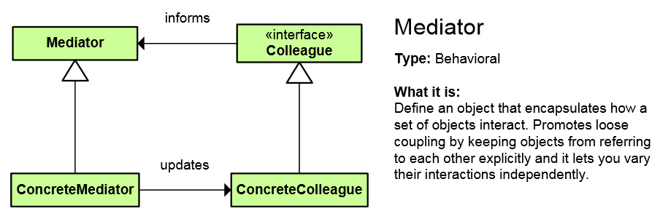
Mediator Pattern
Simplifies communication between classes
Define an object that encapsulates how a set of objects interact
Promotes loose coupling by keeping objects from referring to each other explicitly
Lets you vary their interaction independently

Slide 25
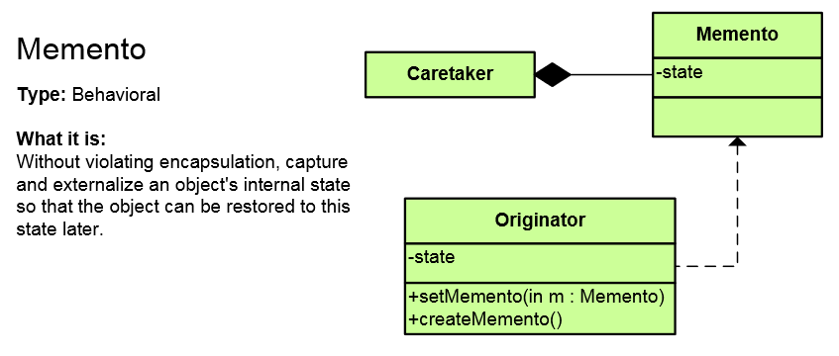
Memento Pattern
Capture and restore an object's internal state
Promote undo or rollback to full object status
A magic cookie that encapsulates a “check point” capability

Slide 26
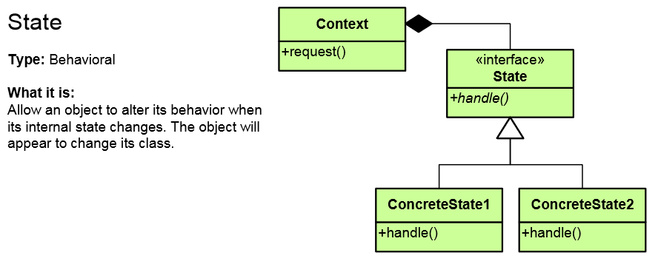
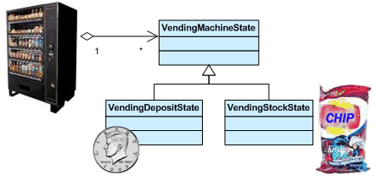
State Pattern
Alter an object's behavior when its state changes
Change behavior of the object with each state
Encapsulate the logic of each state into an object
Allow dynamic state discovery
Make unit testing easier
An object-oriented state machine

Slide 27
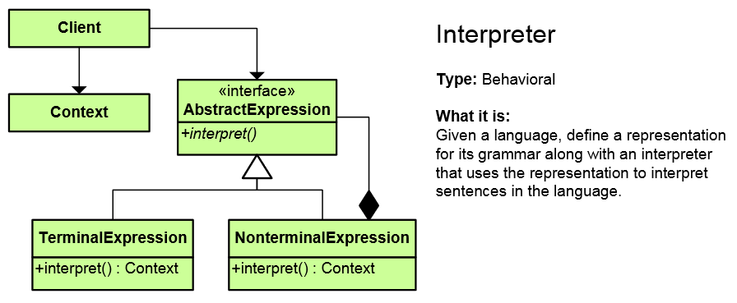
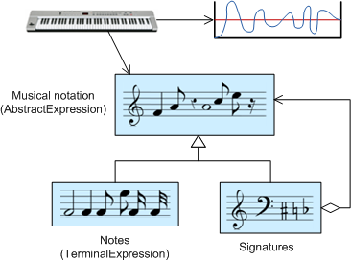
Interpreter Pattern
A way to include language (formal grammar) elements in a program
Define a representation for the grammar
Define an interpreter that uses the representation to interpret sentences in the language

Slide 28
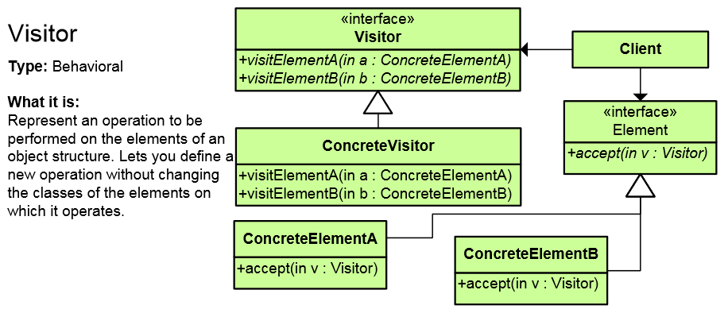
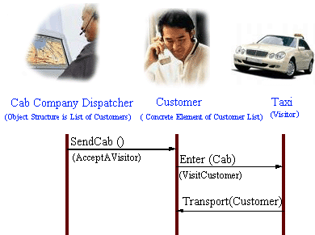
Visitor Pattern
Defines a new operation to a class without changing the elements of the class
The classic technique for recovering lost type information
Do the right thing based on the type of two objects
Double dispatch

Slide 29
Other Behavioral Patterns
Null Object
Designed to act as a default value of an object
In .NET: String.Empty, EventArgs.Empty, etc.
Hierarchical visitor (Composite + Visitor)
Visit every node in a hierarchical data structure
Protocol stack (Upper Layer / Lower Layer)
Scheduled-task
Single-serving visitor (Use and then delete)
Specification pattern (Combine rules (and/or))

Slide 30
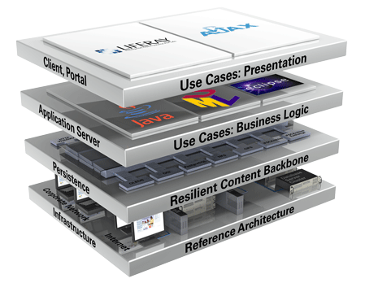
Architectural patterns

Slide 31
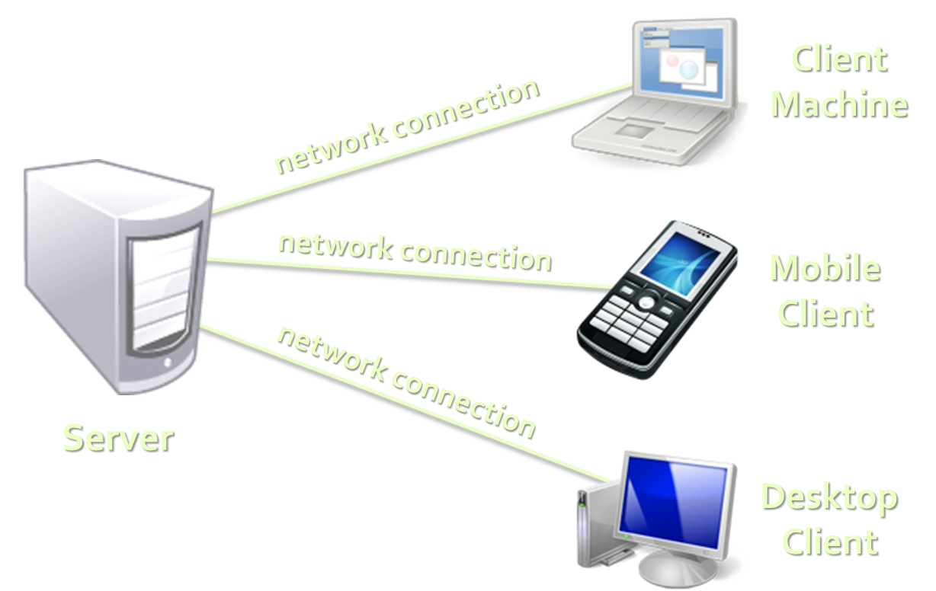
Client-Server Architecture
The client-server model consists of:
Server – a single machine / application that provides services to multiple clients
Could be IIS based Web server
Could be WCF based service
Could be a service in the cloud
Clients –software applications that provide UI (front-end) to access the services at the server
Could be WPF, HTML5, Silverlight, ASP.NET, …

Slide 32
The 3-Tier Architecture
The 3-tier architecture consists of the following tiers (layers):
Front-end (client layer)
Client software – provides the UI of the system
Middle tier (business layer)
Server software – provides the core system logic
Implements the business processes / services
Back-end (data layer)
Manages the data of the system (database / cloud)

Slide 33
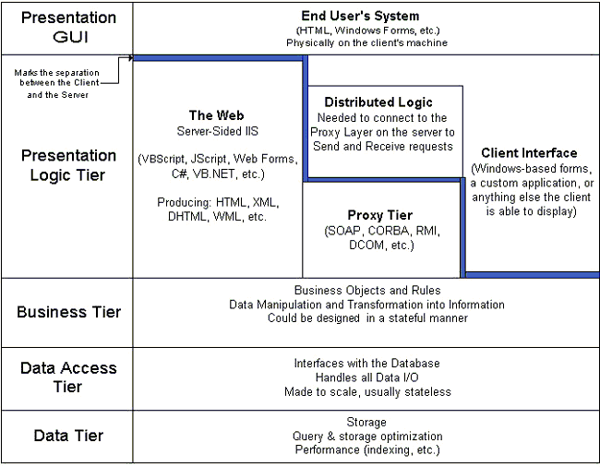
Multi-Tier Architecture
HTML
ASP
.NET
WCF
ORM
DB

Slide 34
Model-View-Controller (MVC)
Model-View-Controller (MVC) architecture
Separates the business logic from application data and presentation
Model
Keeps the application state (data)
View
Displays the data to the user (shows UI)
Controller
Handles the interaction with the user

Slide 35

MVC and Multi-Tier Architecture
MVC does not replace the multi-tier architecture
Both are usually used together
Typical multi-tier architecture can use MVC
To separate logic, data and presentation
Controllers (Business Logic)
Views (Presentation)
Model (Data)
Data Access Logic

Slide 36
Model-View-Presenter (MVP)
Model-View-Presenter (MVP) is UI design pattern similar to MVC
Model
Keeps application data (state)
View
Presentation – displays the UI and handles UI events (keyboard, mouse, etc.)
Presenter
Presentation logic (prepares data taken from the model to be displayed in certain format)

Slide 37
Model-View-ViewModel (MVVM)
Model-View-ViewModel (MVVM) is architectural pattern for modern UI development
Invented by Microsoft for use in WPF and Silverlight
Based on MVC, MVP and Martin Fowler's Presentation Model pattern
Officially published in the Prism project (Composite Application Guidance for WPF and Silverlight)
Separates the "view layer" (state and behavior) from the rest of the application

Slide 38
MVVM Structure
Model
Keeps the application data / state representation
E.g. data access layer or ORM framework
View
UI elements of the application
Windows, forms, controls, fields, buttons, etc.
ViewModel
Data binder and converter that changes the Model information into View information
Exposes commands for binding in the views

Slide 39
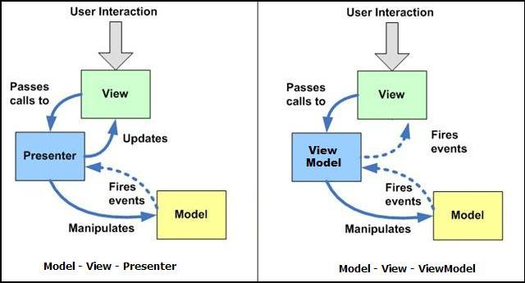
MVP vs. MVVM Patterns
MVVM is like MVP but leverages the platform's build-in bi-directional data binding mechanisms

Slide 40
SOA
Service-Oriented Architecture (SOA) is a concept for development of software systems
Using reusable building blocks (components) called "services"
Services in SOA are:
Autonomous, stateless business functions
Accept requests and return responses
Use well-defined, standard interface

Slide 41
Other Design Patterns
Concurrency patterns
Double Checked Locking pattern
Monitor Object
An object that can be safely used by many threads
Read-Write Lock pattern
Thread Pool pattern
A number of threads are created to perform a number of tasks
And many more

Slide 42
Patterns in .NET Framework
Iterator pattern in foreach loops in C#
Observer pattern – events and event handlers
Adapter pattern is used in ADO.NET
Decorator: CryptoStream decorates Stream
Command in WPF and Silverlight encapsulate a request to call a method with parameters
Façade pattern used in many Win32 API based classes to hide Win32 complexity
Chain of Responsibility is similar to exceptions
String.Empty is a Null Object

Slide 43







Design Patterns II
https://softuni.bg/courses/high-quality-code/

Slide 44

License
This course (slides, examples, demos, videos, homework, etc.) is licensed under the "Creative Commons Attribution-NonCommercial-ShareAlike 4.0 International" license
Attribution: this work may contain portions from
"High Quality Code" course by Telerik Academy under CC-BY-NC-SA license

Slide 45





Free Trainings @ Software University
Software University Foundation – softuni.org
Software University – High-Quality Education, Profession and Job for Software Developers
softuni.bg
Software University @ Facebook
facebook.com/SoftwareUniversity
Software University @ YouTube
youtube.com/SoftwareUniversity
Software University Forums – forum.softuni.bg

